Slide 1
Exception Handling
Chapter 9

Slide 2
Objectives
Describe the notion of exception handling
React correctly when certain exceptions occur
Use Java's exception-handling facilities effectively in classes and programs

Slide 3
Basic Exception Handling: Outline
Exceptions in Java
Predefined Exception Classes

Slide 4
Exceptions in Java
An exception is an object
Signals the occurrence of unusual event during program execution
Throwing an exception
Creating the exception object
Handling the exception
Code that detects and deals with the exception

Slide 5
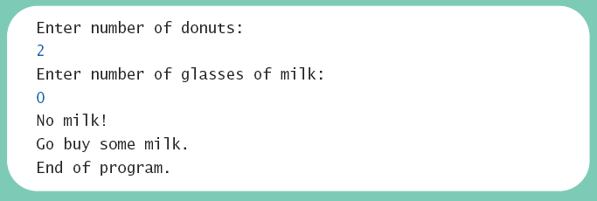
Exceptions in Java
Consider a program to assure us of a sufficient supply of milk
View possible solution, listing 9.1 class GotMilk
Sample screen output

Slide 6
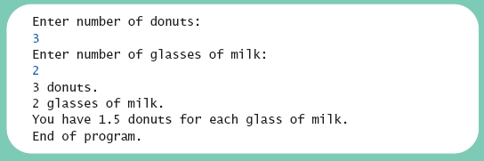
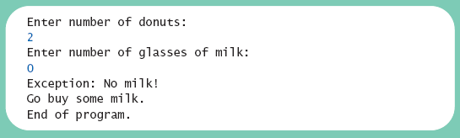
Exceptions in Java
Now we revise the program to use exception-handling
View new version, listing 9.2 class ExceptionDemo
Sample screen output 1
Sample screen output 2

Slide 7
Exceptions in Java
Note try block
Contains code where something could possibly go wrong
If it does go wrong, we throw an exception
Note catch block
When exception thrown, catch block begins execution
Similar to method with parameter
Parameter is the thrown object

Slide 8
Exceptions in Java
Note flow of control when no exception is thrown
View demo with no exception, listing 9.3 class ExceptionDemo
Sample screen output with no exception

Slide 9
Exceptions in Java
Note flow of control when exception IS thrown
View demo with exception, listing 9.4 class ExceptionDemo
Sample screen output when exception is thrown

Slide 10
Predefined Exception Classes
Java has predefined exception classes within Java Class Library
Can place method invocation in try block
Follow with catch block for this type of exception
Example classes
BadStringOperationException
ClassNotFoundException
IOException
NoSuchMethodException

Slide 11
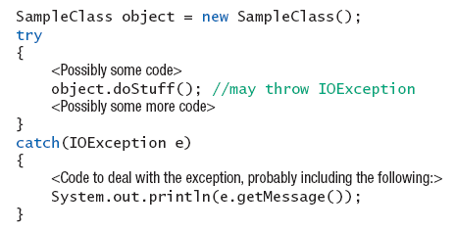
Predefined Exception Classes
Example code

Slide 12
Defining Your Own Exception Classes
Must be derived class of some predefined exception class
Text uses classes derived from class Exception
View sample class, listing 9.5 class DivideByZeroException extends Exception
View demo program, listing 9.6 class DivideByZeroDemo

Slide 13
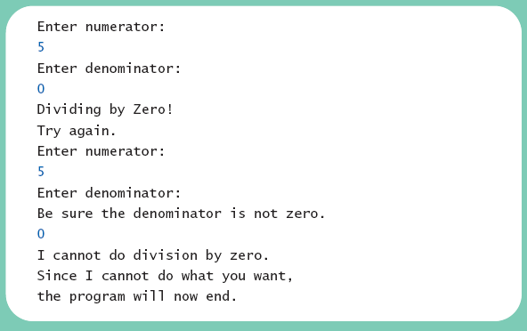
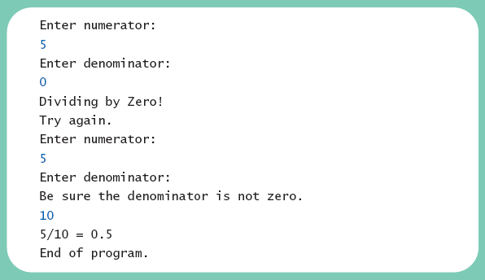
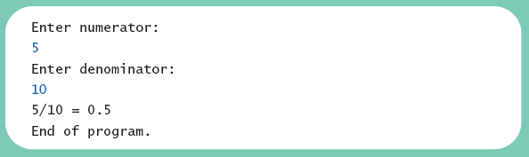
Defining Your Own Exception Classes
Different runs of the program
Sample screen output 1
Sample screen output 3
Sample screen output 2

Slide 14
Defining Your Own Exception Classes
Note method getMessage defined in exception classes
Returns string passed as argument to constructor
If no actual parameter used, default message returned
The type of an object is the name of the exception class

Slide 15
Defining Your Own Exception Classes
Guidelines
Use the Exception as the base class
Define at least two constructors
Default, no parameter
With String parameter
Start constructor definition with call to constructor of base class, using super
Do not override inherited getMessage

Slide 16
More About Exception Classes: Outline
Declaring Exceptions (Passing the Buck)
Kinds of Exceptions
Errors
Multiple Throws and Catches
The finally Block
Rethrowing an Exception
Case Study: A Line-Oriented Calculator

Slide 17
Declaring Exceptions
Consider method where code throws exception
May want to handle immediately
May want to delay until something else is done
Method that does not catch an exception
Notify programmers with throws clause
Programmer then given responsibility to handle exception

Slide 18
Declaring Exceptions
Note syntax for throws clause
Note distinction
Keyword throw used to throw exception
Keyword throws used in method heading to declare an exception

Slide 19
Declaring Exceptions
If a method throws exception and exception not caught inside the method
Method ends immediately after exception thrown
A throws clause in overriding method
Can declare fewer exceptions than declared
But not more
View program example, listing 9.7 class DoDivision

Slide 20
Kinds of Exceptions
In most cases, exception is caught …
In a catch block … or
Be declared in throws clause
But Java has exceptions you do not need to account for
Categories of exceptions
Checked exceptions
Unchecked exceptions

Slide 21
Kinds of Exceptions
Checked exception
Must be caught in catch block
Or declared in throws clause
Unchecked exception
Also called run-time
Need not be caught in catch block or declared in throws
Exceptions that coding problems exist, should be fixed

Slide 22
Kinds of Exceptions
Examples why unchecked exceptions to are thrown
Attempt to use array index out of bounds
Division by zero
Uncaught runtime exception terminates program execution

Slide 23
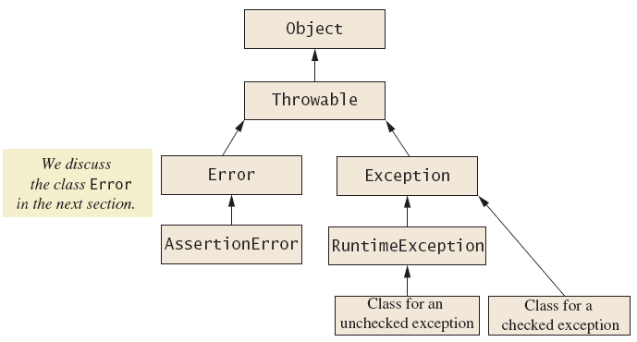
Kinds of Exceptions
Figure 9.1 Hierarchy of the predefined exception classes

Slide 24
Errors
An error is an object of class Error
Similar to an unchecked exception
Need not catch or declare in throws clause
Object of class Error generated when abnormal conditions occur
Errors are more or less beyond your control
Require change of program to resolve

Slide 25
Multiple Throws and Catches
A try block can throw any number of exceptions of different types
Each catch block can catch exceptions of only one type
Order of catch blocks matter
View example program, listing 9.8 class TwoCatchesDemo
View exception class used, listing 9.9 class NegativeNumberException

Slide 26
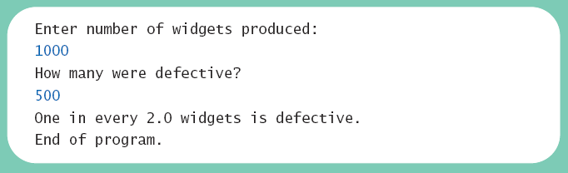
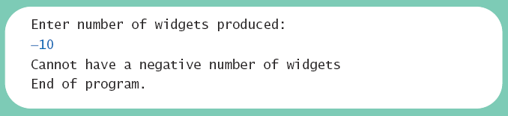
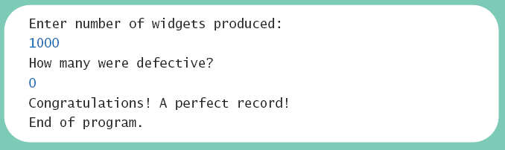
Multiple Throws and Catches
Note multiple sample runs
Sample screen output 1
Sample screen output 2
Sample screen output 2

Slide 27
Multiple Throws and Catches
Exceptions can deal with invalid user input
To handle an exception thrown by a method
It does not matter where in the method the throw occurs
Use of throw statement be should be reserved for cases where it is unavoidable
Text suggests separate methods for throwing and catching of exceptions
Nested try-catch blocks rarely useful

Slide 28
The finally Block
Possible to add a finally block after sequence of catch blocks
Code in finally block executed
Whether or not execution thrown
Whether or not required catch exists

Slide 29
Rethrowing an Exception
Legal to throw an exception within a catch block
Possible to use contents of String parameter to throw same or different type exception

Slide 30
Case Study
A Line-Oriented Calculator
Should do addition, subtraction, division, multiplication
Will use line input/output
User will enter
Operation, space, number
Calculator displays result

Slide 31
Case Study
Proposed initial methods
Method to reset value of result to zero
Method to evaluate result of one operation
Method doCalculation to perform series of operations
Accessor method getResult: returns value of instance variable result
Mutator method setResults: sets value of instance variable result

Slide 32
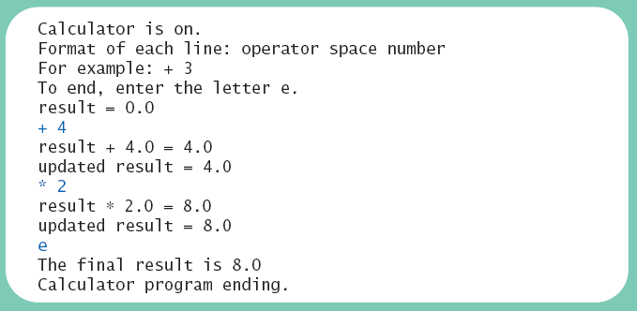
Case Study
View exception class, listing 9.10 class UnknownOpException
View first version of calculator, listing 9.11 class PreLimCalculator
Sample screen output

Slide 33
Case Study
Final version adds exception handling
Ways to handle unknown operator
Catch exception in method evaluate
Let evaluate throw exception, catch exception in doCalculation
Let evaluate, doCalculation both throw exception, catch in main
Latter option chosen

Slide 34
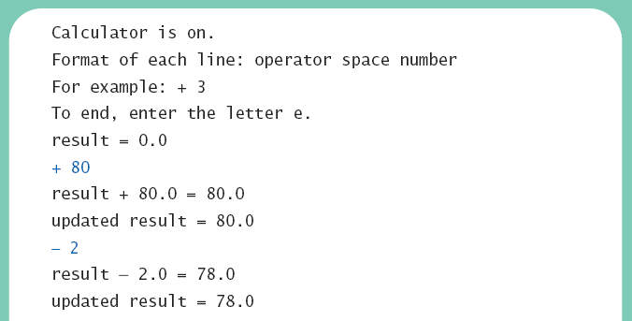
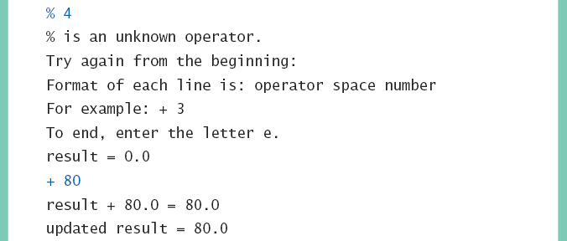
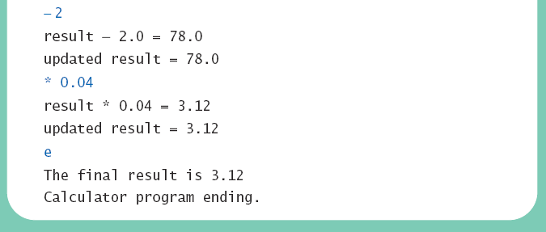
Case Study
View final version, listing 9.12 class Calculator
Sample screen output

Slide 35
Graphics Supplement: Outline
Additional User Interface Controls and Shapes
Handling Mouse Events
Introduction to the Timeline

Slide 36
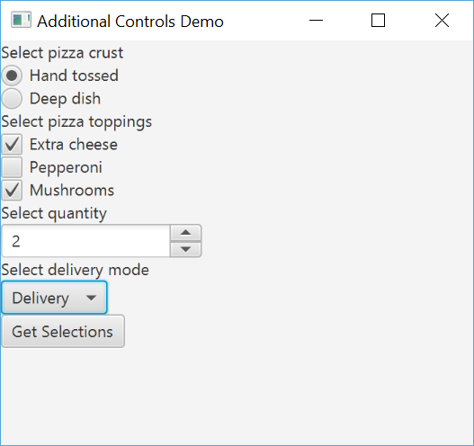
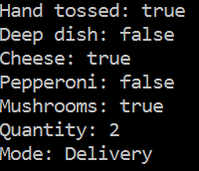
Additional User Controls
CheckBox, RadioButton (in ToggleGroup), Spinner, and ChoiceBox demo
Example selecting pizza options
View controls demo, listing 9.13 class AdditionalControlsDemo

Slide 37
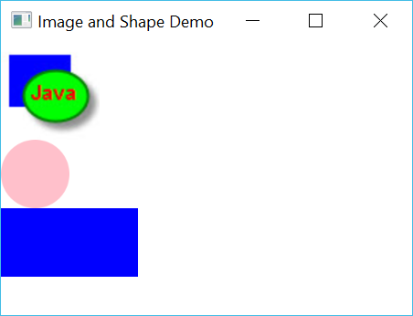
Images and Shapes
We can load and display images with the Image object placed into an ImageView and added to the pane
Shape objects can be manipulated unlike drawing shapes using stroke/fill
View image demo, listing 9.14 class ImageShapeDemo

Slide 38
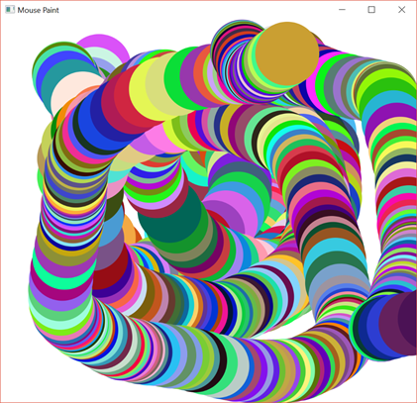
Mouse Click and Mouse Move Events
Mouse events are handled in essentially the same manner that we used to handle button clicks except we implement EventHandler<MouseEvent> and override setOnMousePressed for mouse clicks and setOnMousePressed for mouse motion
View mouse demo1, listing 9.15, class MousePaint

Slide 39
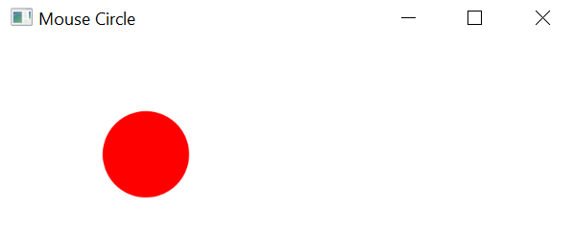
Moving a Circle Object to the Mouse Location
Instead of painting circles this program moves a Circle object to the coordinates of the mouse every time the mouse is moved
View mouse demo2, listing 9.16, class MouseCircle

Slide 40
Timeline
The Timeline class is used to create animations
In this example we simply move a ball around the screen
The ball has velocity in the x and y directions
The timeline object has a keyframe that contains an ActionEvent handler
View ball, listing 9.17, class Ball
View bouncing ball, listing 9.18, class BounceBall

Slide 41
Summary
An exception is an object derived from class Exception
Descendants of class Error behave like exceptions
Exception handling allows design of normal cases separate from exceptional situations
Two kinds of exceptions
Checked and unchecked

Slide 42
Summary
Exceptions can be thrown by
Java statements
Methods from class libraries
Programmer use of throw statement
Method that might throw but not catch an exception should use throws clause
Exception is caught in catch block

Slide 43
Summary
A try block followed by one or mor catch blocks
More specific exception catch types should come first
Every exception type has getMessage method usable to recover description of caught description
Do not overuse exceptions
Other GUI controls include radio buttons, check boxes, and spinners
Mouse event handlers can capture button clicks and mouse motion
The Timeline object is used for animation

